Slide 1

First Phase Review
Dog Breed Identification with Product Classification and Assisted Services
Batch No: 2020_CSE_06
Ruchitha G K - 1KS17CS066
Spoorthi R - 1KS17CS081
Varun Attiganal Venkatesh - 1KS17CS096
Under the guidance of:
Dr. Swathi K
Assistant Professor, Dept of CSE
‹#›

Slide 2
Contents
Introduction
Literature Survey
Problem Identification
Problem Statement
Scope
Goals and Objectives
Methodology
Expected Outcomes
Contribution to Society
References

Slide 3
Introduction
The demand for having a pet at home has been increasing drastically over the past few years. People are considering pets to be an important addition to the family.
The population of pet dogs in India amounted for around 19.5 million in the year 2018. The population was forecast to reach over 31 million by the end of year 2023.
The growth in the number of pet dogs in India had led to the increase in pet food and products, from approximately 139 million U.S. dollars in 2014 to approximately 285 million dollars in 2018.

Slide 4
Literature Survey
[1]. Viola, P.; Jones, M. Rapid object detection using a boosted cascade of simple features. In Proceedings of the 2001 IEEE Computer Society Conference on Computer Vision and Pattern Recognition. CVPR 2001, volume 1, 2001, ISSN 1063-6919, pp. I–511–I–518 vol.1, doi:10.1109/CVPR.2001.990517.
[2]. https://www.petsworld.in/ - the idea of food, accessories are referred from this website.

Slide 5
Problem Identification
Pet owners might find it difficult to identify the breed of the pet in its early stages.
They end up buying wrong food that could affect health.
They end up using wrong accessories which could harm the pet physically.
Some often find it hard to navigate between many websites.

Slide 6
Problem Statement
There has always been a need for a centralized platform where the breed of dog is recognized and suitable products and services are available to pet owners.

Slide 7
Scope
Registration
Breed classification
Vet and grooming services
Food and products specific to breed and age
Lost and found pets

Slide 8
Goals and Objectives
Identification of dog breeds
Recommend species/breed specific food and products assisted by breed classification
Facilitate recovery of stolen or lost dogs
Recommend grooming and vet services

Slide 9
Methodology
The user uploads the image of their dog
The system detects the breed of the dog in two steps
1) Extracting a target image- YOLO is used to crop out the excess in a image to obtain only the target image.
2) Classification-inception transfer learning is used to compare the target image and return the breed of the dog.
Keggle dataset is used to train and test the machine
After the identification of the dog breed, products and accessories related to that breed are classified and displayed to the user so that the user can make the right choice of product for their dog

Slide 10
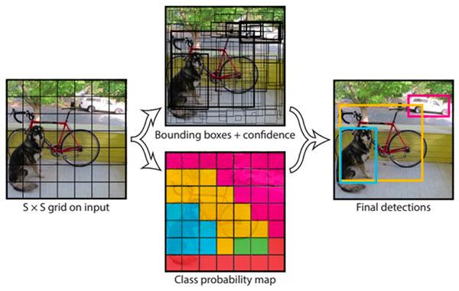
YOLO Design

Slide 11
Block Diagram
DOG BREED CLASSIFIER SYSTEM
Pet detected
Consumer/
Found a dog
Image of pet
Breed detection
Breed classifier
Results matched with existing categories
Producer/
Service provider/lost a dog
Image and info about products pet and services
Products/services and pet sorted based on breed
‹#›

Slide 12
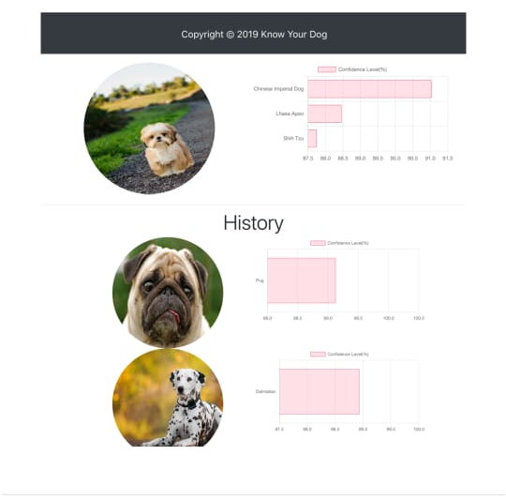
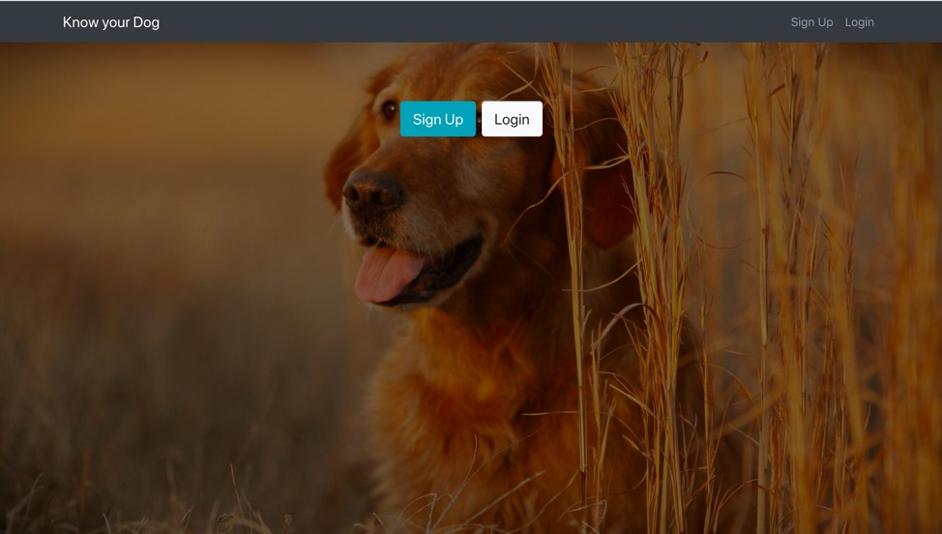
Expected Outcomes

Slide 13
Contribution to Society
We propose a trained model which uses some techniques to detect the breed of the dog. This classification is important because we are using this criteria to sort out food and accessories, and lost dogs so that pet owners can find anything they want very easily.
A lot of confusion related to identifying the breed will bring the selling of wrong dogs under control.
A centralized platform avoids the user from switching multiple tabs.

Slide 14
References
[1]. Viola, P.; Jones, M. Rapid object detection using a boosted cascade of simple features. In Proceedings of the 2001 IEEE Computer Society Conference on Computer Vision and Pattern Recognition. CVPR 2001, volume 1, 2001, ISSN 1063-6919, pp. I–511–I–518 vol.1, doi:10.1109/CVPR.2001.990517.
[2]. Geethapriya. S, N. Duraimurugan, S.P. Chokkalingam Real-Time Object Detection with Yolo. International Journal of Engineering and Advanced Technology (IJEAT) ISSN: 2249 – 8958, Volume-8, Issue-3S, February 2019.
[3]. Joseph Redmon , Santosh Divvala, Ross Girshick , Ali Farhadi You Only Look Once: Unified, Real-Time Object Detection.
[4]. https://www.petsworld.in/ - the idea of food, accessories are referred from this website.

Slide 15
Queries??

Slide 16
Thank You

